Slide 1
SwiftFest RAY-20-OFF

Slide 2
for developers
@ray_deck

Slide 3
react-native-swift react-native-swift-cli react-native-coreml react-native-pods react-native-ios-setfamily react-native-appicons react-native-launchimages react-native-setdevteam react-native-xcode

Slide 4
facebook 2015

Slide 5
JavaScript As Orchestrator

Slide 6
RCTRootView
View
JavascriptCore
RCTBridge
Fetch
Animation

Slide 7
> yarn global add react-native-cli > react-native init <myprojectname> > cd <myprojectname> > code . > react-native run-ios

Slide 8
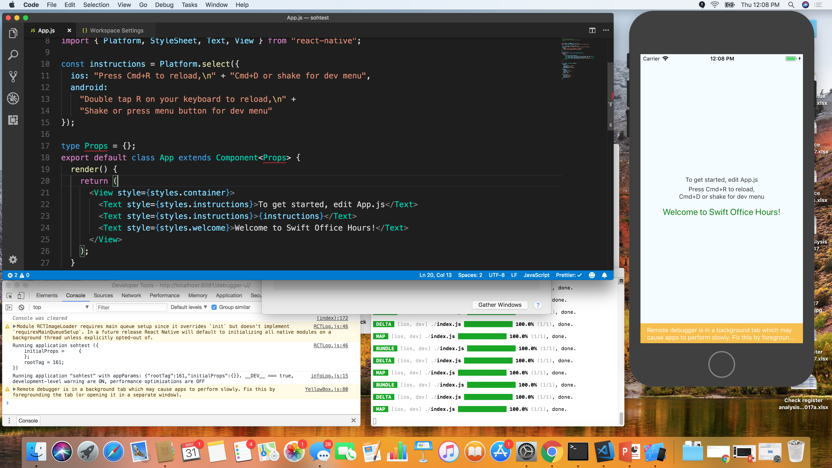

Slide 9
Rapid Reloading Code as Asset React

Slide 10
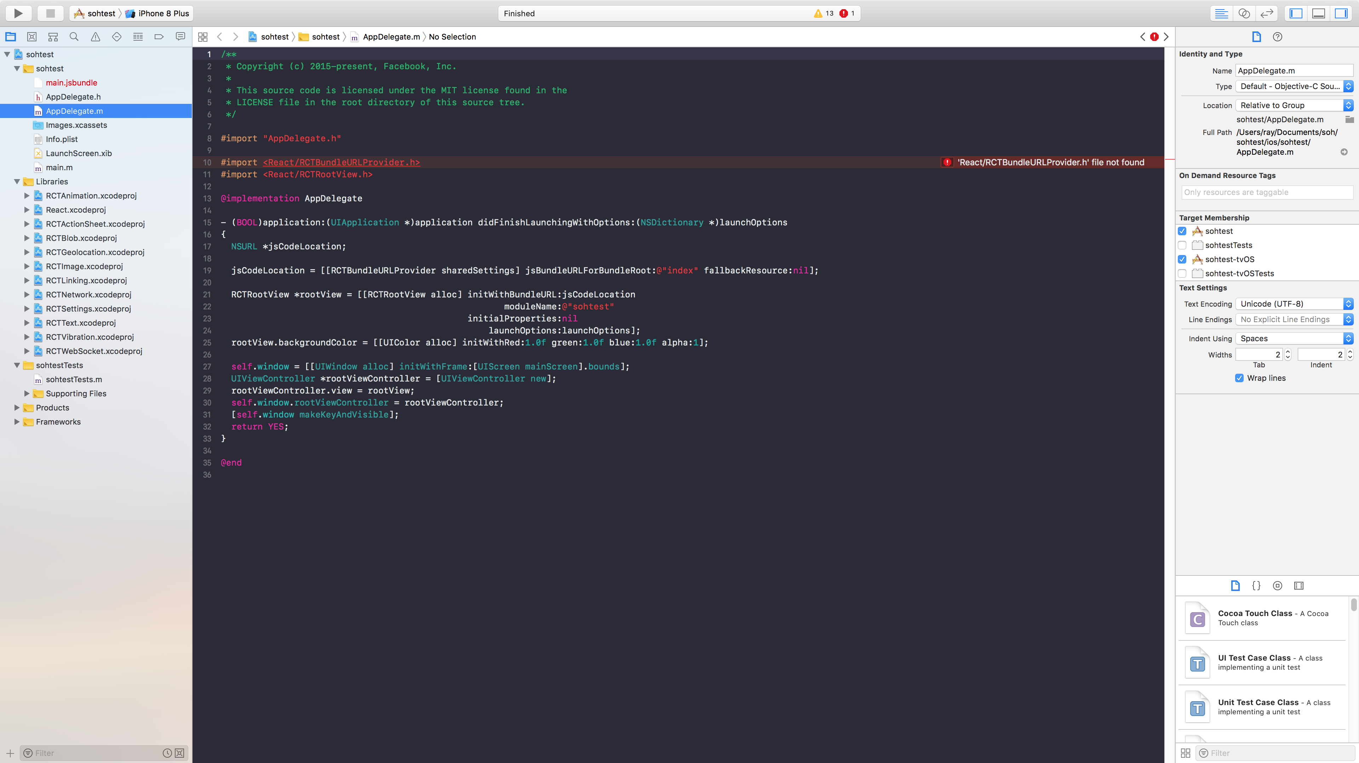

Slide 11
react-native link 2016

Slide 12
> react-native init <myproject> ; \ yarn add react-native-camera; react-native link; react-native run-ios; code .

Slide 13
RCTRootView
RCTEventEmitter
JavascriptCore
RCTBridge
RCTViewManager
RCTBridgeModule

Slide 14
#import <React/RCTViewManager.h>
#import <React/RCTEventEmitter.h>
#import <React/RCTBridgeModule.h>
@interface RCT_EXTERN_MODULE(RNSBoston, RCTEventEmitter)
RCT_EXTERN_METHOD(demo:(NSString *)message success:(RCTPromiseResolveBlock)success reject:(RCTPromiseRejectBlock)reject);
RCT_EXTERN_METHOD(delayedSend:(NSString *)message ms:(NSInteger)ms);
@end
@interface RCT_EXTERN_MODULE(RNSBostonBasicViewManager, RCTViewManager)
@end
@interface RCT_EXTERN_MODULE(RNSBostonViewManager, RCTViewManager)
RCT_EXTERN_METHOD(takePicture:(RCTPromiseResolveBlock)resolve reject:(RCTPromiseRejectBlock)reject);
RCT_EXPORT_VIEW_PROPERTY(onStart, RCTBubblingEventBlock);
RCT_EXPORT_VIEW_PROPERTY(cameraFront, BOOL);
@end

Slide 15
Xcode 9 2017

Slide 16
react-native-swift
2017

Slide 17
react-native-swift react-native-swift-bridge
2018

Slide 18
react-native-swift react-native-swift-bridge react-native-swift-cli
2018

Slide 19
> yarn global add react-native-swift-cli > react-native-swift init <mymodule> > rns makeapp <appname> <mymodule> > cd <mymodule> > yarn watch > code . > cd ../<appname> > react-native xcode

Slide 20
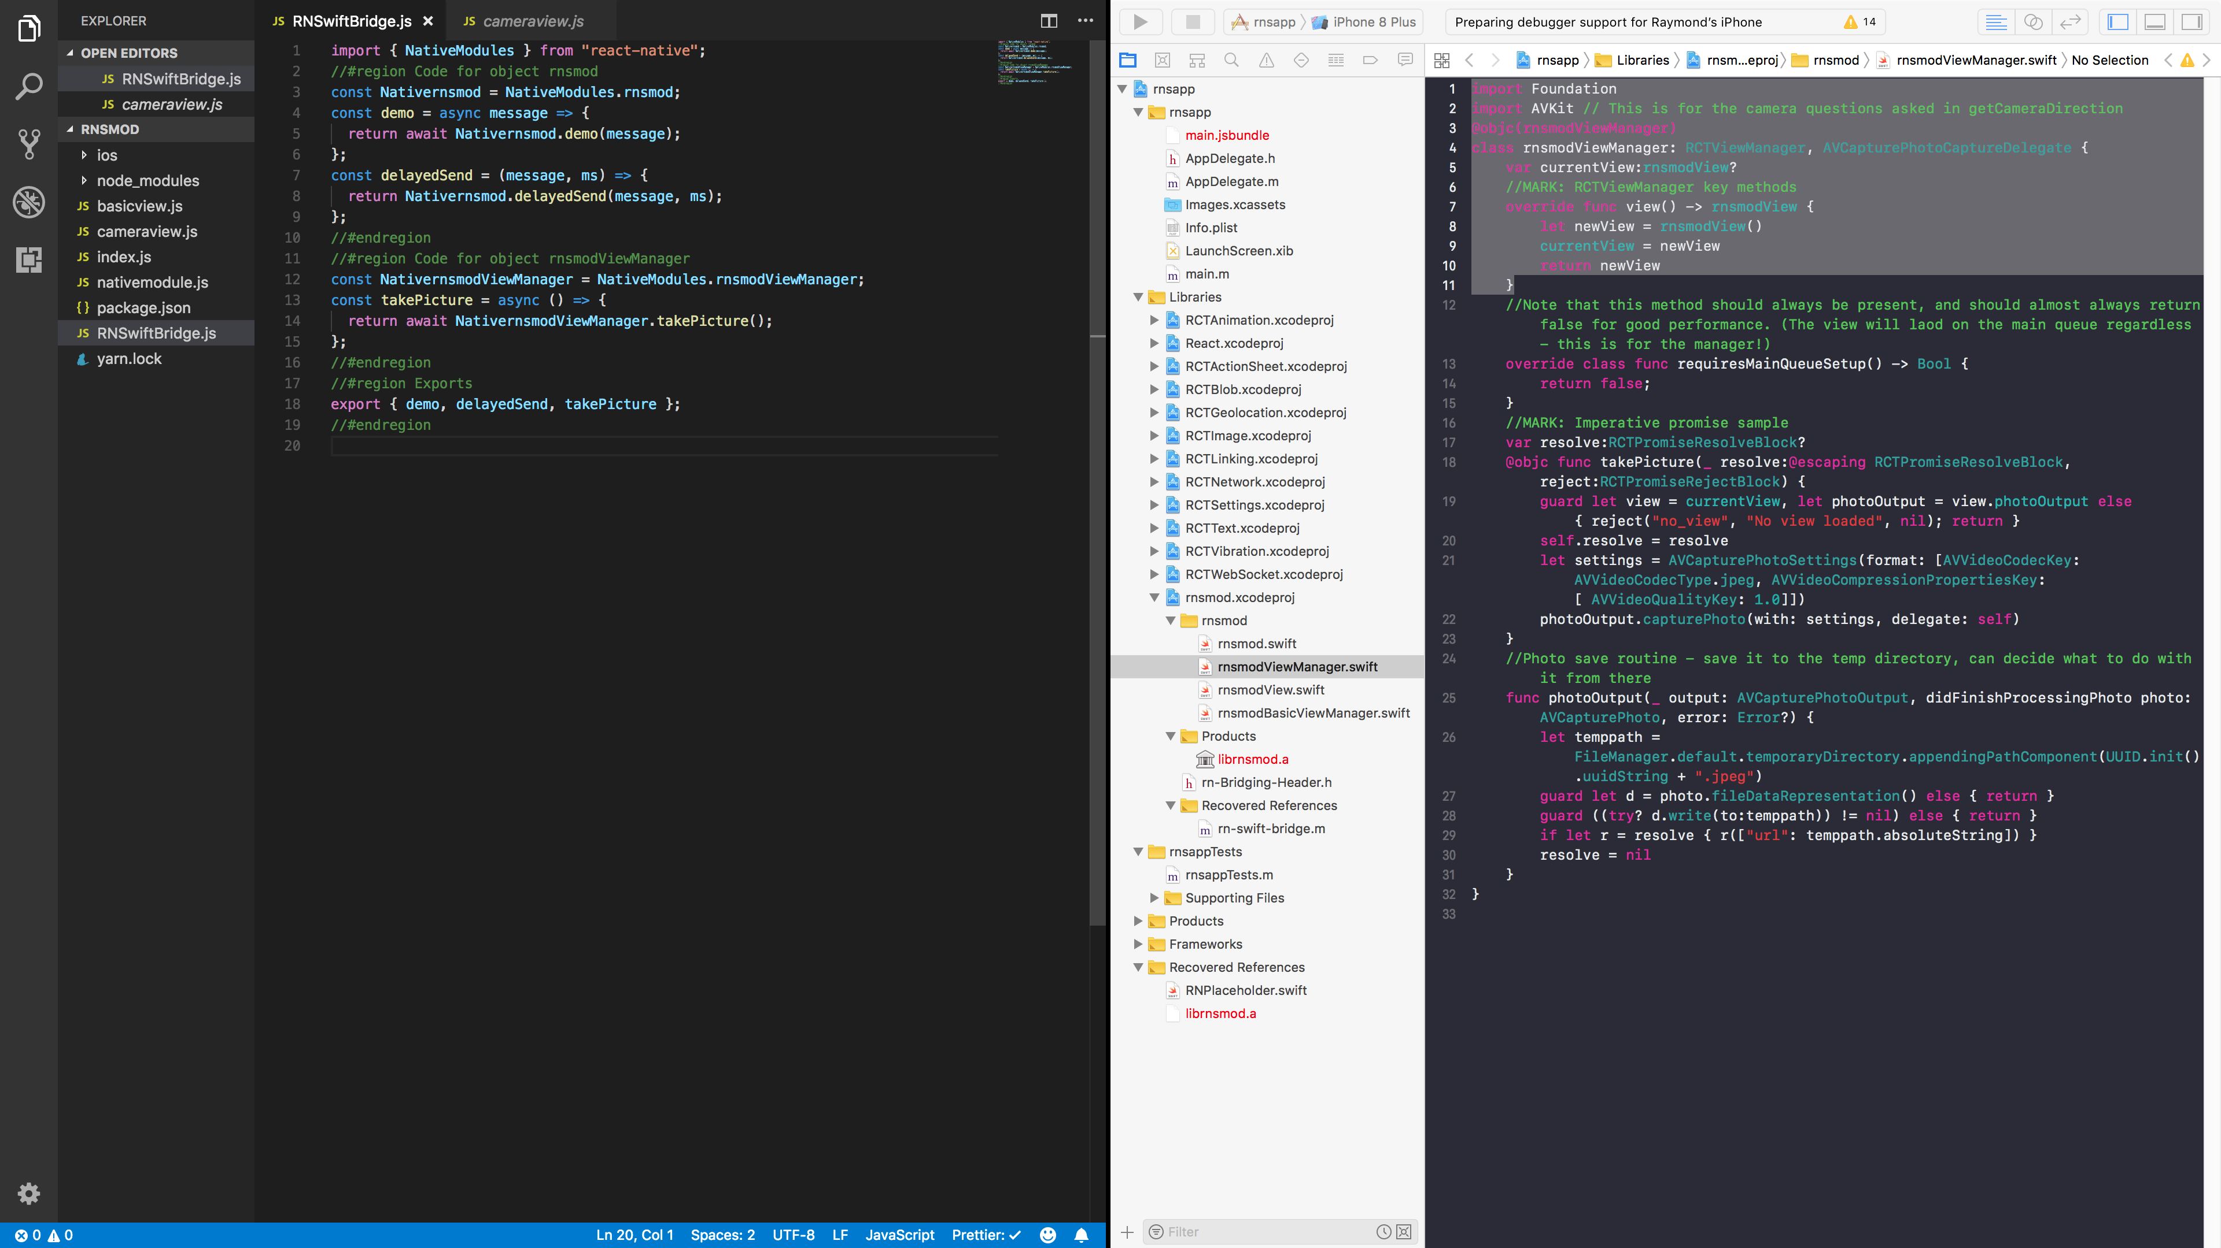
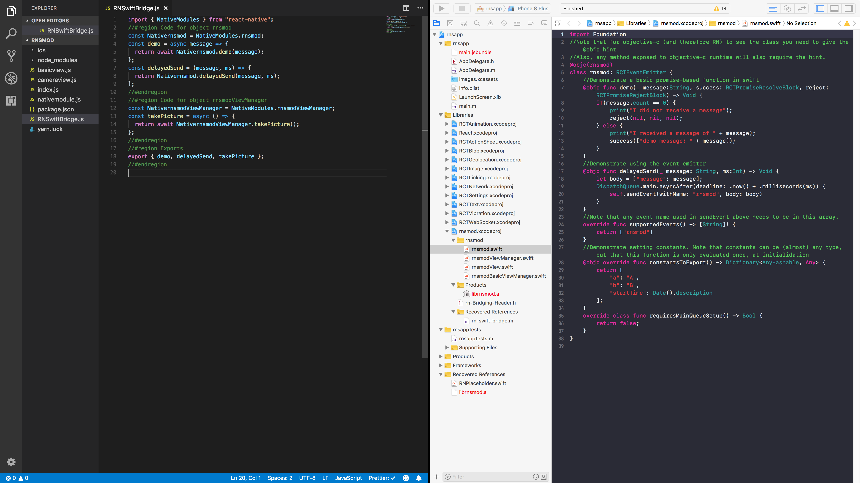

Slide 21
Promise-Based Communication

Slide 23
//MARK: RN Methods
@objc func compileModel(_ source: String, success:@escaping RCTPromiseResolveBlock, reject:@escaping RCTPromiseRejectBlock) ->Void {
DispatchQueue(label: "RNCoreML").async() {
let url = URL(fileURLWithPath: source)
do {
let tempURL:URL = try MLModel.compileModel(at:url)
success(tempURL.path);
} catch {
reject(nil, nil, error);
}
}
}
@objc func classifyImageWithModel(_ source: String, modelPath: String, success:@escaping RCTPromiseResolveBlock, reject:@escaping RCTPromiseRejectBlock) ->Void {
guard let thisModel = getModel(modelPath) else { reject("no_model", "Could not load model with path" + modelPath, nil); return }
do {
let imageURL = URL(fileURLWithPath: source)
let vModel = try VNCoreMLModel(for: thisModel);
let image = CIImage(contentsOf: imageURL);
let handler = VNImageRequestHandler(ciImage: image!);
let request = VNCoreMLRequest(model: vModel) { (req, e) -> Void in
if let results = req.r

Slide 25
import { NativeModules } from "react-native";
const RNCoreML: RNCoreMLClass = NativeModules.RNCoreML;
const compileModel = async sourcepath => {
return await RNCoreML.compileModel(sourcepath);
};
const classifyImage = async (imagePath, modelPath) => {
return await RNCoreML.classifyImageWithModel(imagePath, modelPath);
};

Slide 26
UI Element Integration

Slide 28
import Foundation
import AVKit // This is for the camera questions asked in getCameraDirection
@objc(rnsmodViewManager)
class rnsmodViewManager: RCTViewManager, AVCapturePhotoCaptureDelegate {
var currentView:rnsmodView?
//MARK: RCTViewManager key methods
override func view() -> rnsmodView {
let newView = rnsmodView()
currentView = newView
return newView
}

Slide 30
import { requireNativeComponent, NativeModules } from "react-native";
import React, { Component } from "react";
const NativeView = requireNativeComponent("rnsmodView", CameraView);
class CameraView extends Component {
render() {
return <NativeView {...this.props} />;
}
}
CameraView.takePicture = async () => {
try {
const x = await NativeModules.rnsmodViewManager.takePicture();
return x;
} catch (e) {return null;
}
};
export default CameraView;

Slide 31
<TouchableOpacity
onPress={async () => {
const result = await CameraView.takePicture();
console.log("I got a result!!!", result);
const newText = result
? "Took a picture!"
: "Error taking picture";
this.setState({ cameraText: newText, imageURL: result.url });
}}
>
<CameraView
style={{ width: "100%", height: 300 }}
cameraFront={this.state.cameraFront}
/>
</TouchableOpacity>

Slide 32
Business Logic Extended Functionality Low-level Affordance

Slide 33
plist pbxproj FastLane

Slide 34
> react-native init <myproject> ; \ yarn add react-native-coreml \ react-native-swift \ react-native-camera \ react-native-setdevteam \ react-native-fix-ios-version; react-native setdevteam ; react-native link; react-native run-ios --device; code .

Slide 35
Let Designers Tweak Let Coders Create

Slide 36
Swift that Matters

Slide 37
Thank You https://github.com/rhdeck/rn-for-swift-devs

